Slide 1

Natural Language Processing Converting a Text to a Vector

Slide 2
Natural Language Processing
Introduction to NLP
Applications of NLP
Revisit AI project cycle
ChatBots
Basic Concepts of NLP

Slide 3
Introduction to Natural Language Processing

Slide 4
Natural Language Processing
Natural Language Processing, or NLP, is the sub-field of AI that is focused on enabling computers to understand and process human languages.
It is a subfield of Linguistics, Computer Science, Information Engineering, and Artificial Intelligence concerned with the interactions between computers and human (natural) languages, in particular how to program computers to process and analyse large amounts of natural language data.

Slide 5
NLP game (Mystery Animal)
https://experiments.withgoogle.com/mystery-animal
Launch the experiment
Allow mic
And start asking.

Slide 6
Applications of NLP
Text summarization
Sentiment Analysis
Language Translation
Text classification
Virtual assistants
Chatbots
Social media monitoring

Slide 7
CBT
CBT includes understanding the behaviour and mindset of a person in their normal life.
With the help of CBT, therapists help people overcome their stress and live a happy life
It has been observed that people do not wish to seek the help of a psychiatrist willingly.
They try to avoid such interactions as much as possible.
Thus, there is a need to bridge the gap between a person who needs help and the psychiatrist.
Let us look at various factors around this problem through the 4Ws problem canvas.

Slide 8
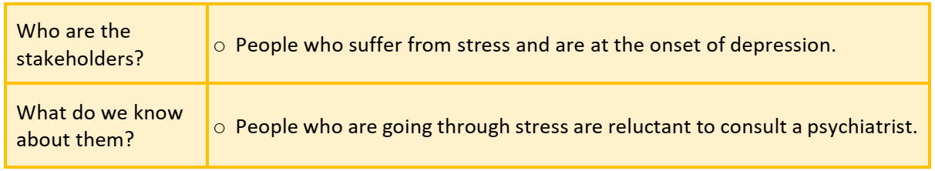
Who

Slide 9
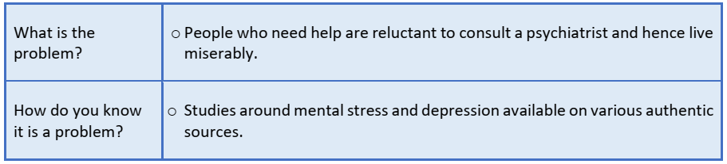
What

Slide 10
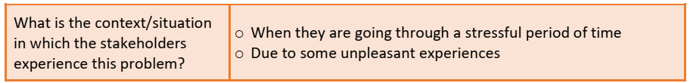
Where

Slide 11
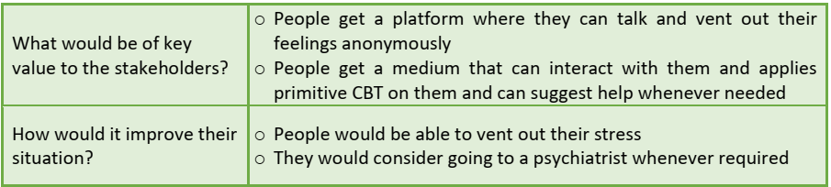
Why

Slide 12
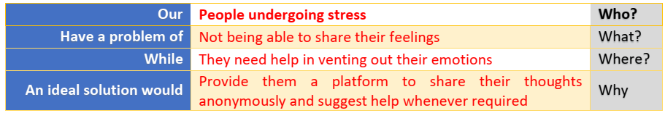
Template

Slide 13
Aim:
We aim to develop a Chatbot which will interact with the people
It will extract the information from the answers and help help them to vent out their feelings and take them through primitive CBT

Slide 14
Data acquisition
To comprehend the sentiments of people, we should prepare the relevant dataset.
Need to collect conversation based dataset.
Machine should be able to comprehend and interpret the meanings from these words.
Data can be collected by :
Surveys
Observations
Internet
Interviews

Slide 15
Data Exploration
Once the textual data has been collected, it needs to be processed and cleaned so that an easier version can be sent to the machine.
Thus, the text is normalised through various steps and is lowered to minimum vocabulary since the machine does not require grammatically correct statements but the essence of it.
These steps are also called pre-processing steps.

Slide 16
Modeling
Once the text has been normalised, it is then fed to an NLP based AI model.
Note that in NLP, modelling requires data pre-processing only after which the data is fed to the machine.
Depending upon the type of chatbot we try to make, there are a lot of AI models available which help us build the foundation of our project.

Slide 17
Evaluation
The model trained is then evaluated and the accuracy for the same is generated on the basis of the relevance of the answers which the machine gives to the user’s responses.
To understand the efficiency of the model, the suggested answers by the chatbot are compared to the actual answers

Slide 18
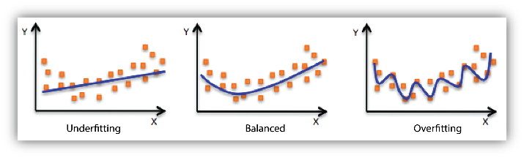
Model Fit: underfitting and overfitting
Your model is underfitting the training data when the model performs poorly on the training data.
This is because the model is unable to capture the relationship between the input examples (often called X) and the target values (often called Y).
Your model is overfitting your training data when you see that the model performs well on the training data but does not perform well on the evaluation data.
This is because the model is memorizing the data it has seen and is unable to generalize to unseen examples.

Slide 19
Analogy
Let’s say three students have prepared for a mathematics examination.
The first student has only studied Addition mathematic operations and skipped other mathematics operations such as Subtraction, Division, Multiplication etc.
The second student has a particularly good memory. Thus, second student has memorized all the problems presented in the textbook.
And the third student has studied all mathematical operations and is well prepared for the exam.

Slide 20
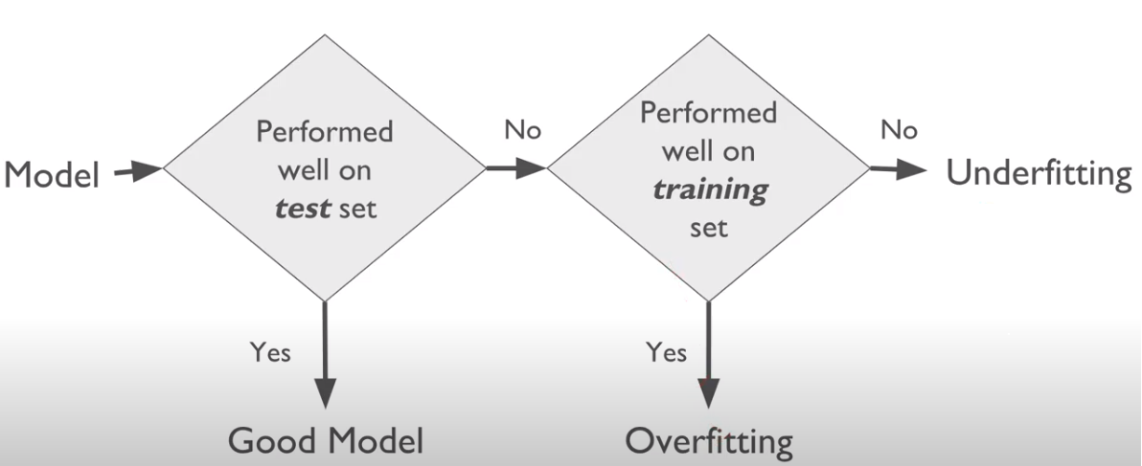

Slide 21
Machine Learning algorithms have similar behavior to our three students, sometimes the model generated by the algorithm are similar to the first student. They learn from only from a small part of the training dataset, in such cases the model is Underfitting.
Sometimes the model will memorize the entire training dataset, like the second student. They perform very well on known instances, but faulter badly on unseen data or unknown instances. In such cases the model is said to be Overfitting.
And when model does well in both the training dataset and on the unseen data or unknown instances like student three, it is a good fit.

Slide 22
Try it yourself.
Prepare a similar template to design a system which can translate English to Hindi to help people understand English in a better way.

